Slide 1
Device Model User Guide
Chia-Jen Liang, Edward Yeuan

Slide 2
Contents
Device Types
Model Setup
Pre-simulation
Post-simulation
Model Comparison Results
THz_NMOS_CS
MOS_BGDSGB_CG
MOS_SGDGS_CS
MOS_BSGGDB_Gilbert
PowerM_CSAr
PowerM_CCAr_longL

Slide 3
Device Types
THz MOS
THz_NMOS_CS
Analog MOS
MOS_BGDSGB_CG
MOS_SGDGS_CS
MOS_BSGGDB_Gilbert
Power MOS
PowerM_CSAr
PowerM_CCAr_longL

Slide 4
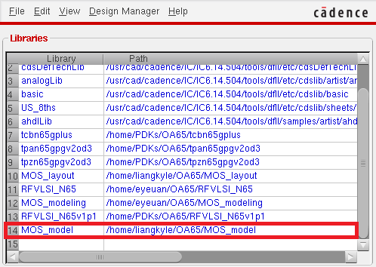
Pre-simulation
Add library path: /home/liangkyle/OA65/MOS_model

Slide 5
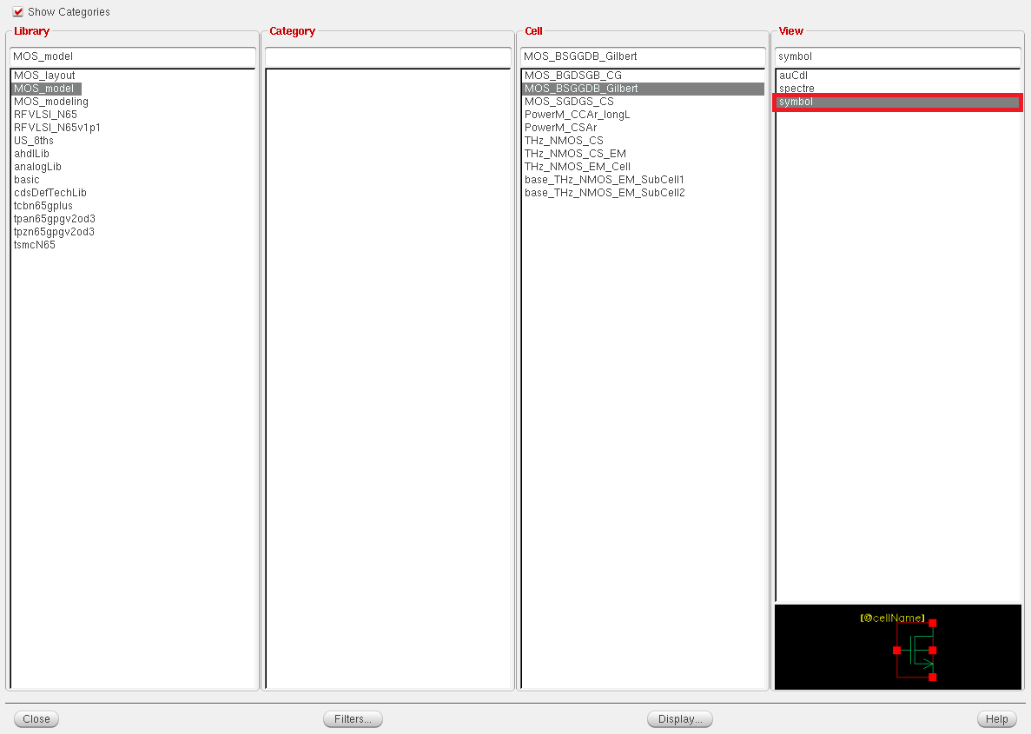
Use custom symbol for simulation

Slide 6
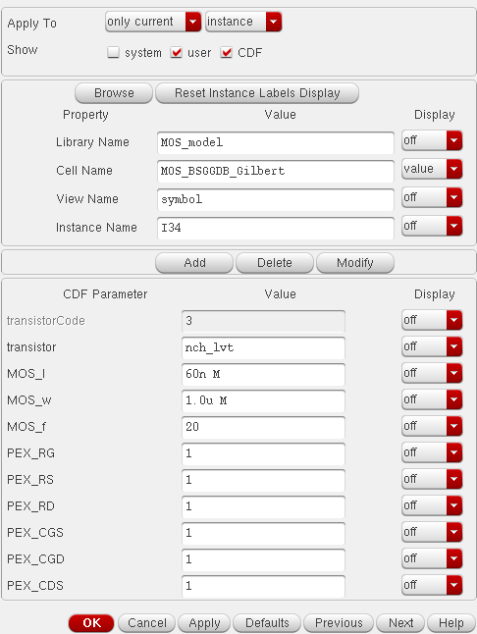
Parameter PEX_Parasitics are used to estimate the effect of increasing or decreasing parasitics in pre-simulation (default is 1), they will all be neglected in post-simulation
Example: 20% increase in Cgs, PEX_CGS = 1.2

Slide 7
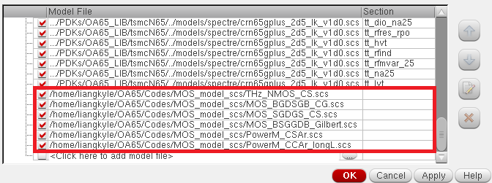
Add model file in ADE model libraries:
/home/liangkyle/OA65/Codes/MOS_model_scs/DeviceName.scs

Slide 8
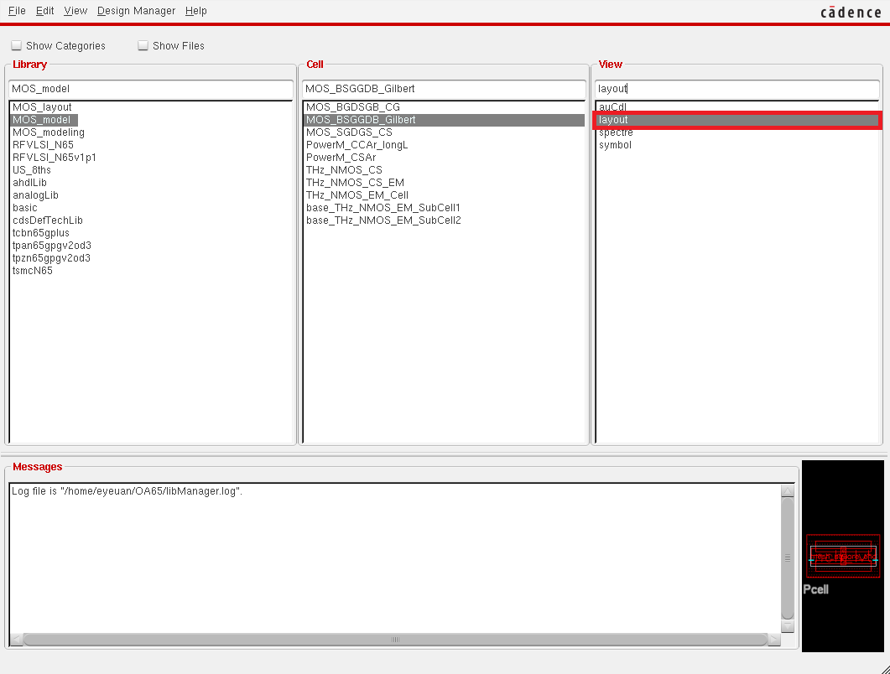
Post-simulation
Use custom layout

Slide 9
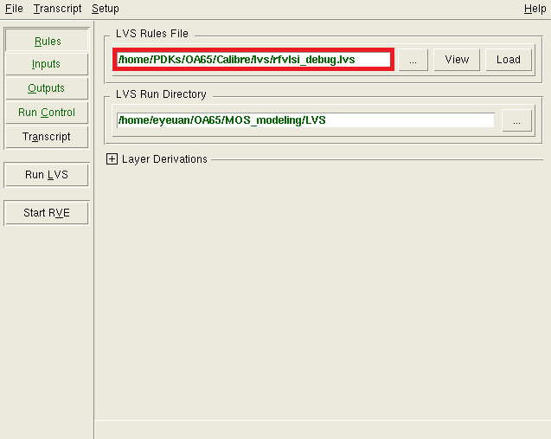
Use LVS rule file:
/home/PDKs/OA65/Calibre/lvs/rfvlsi_debug.lvs

Slide 10
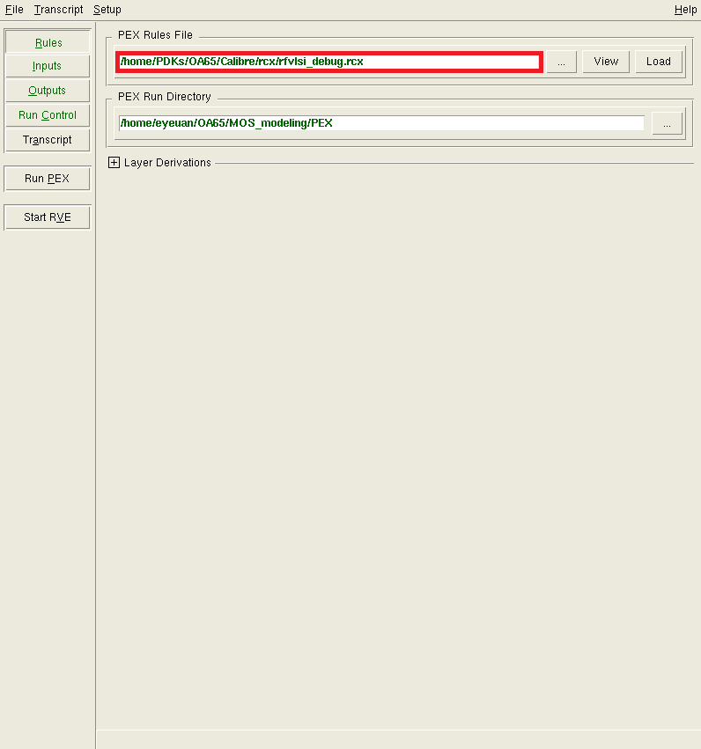
Use PEX rule file:
/home/PDKs/OA65/Calibre/rcx/rfvlsi_debug.rcx

Slide 11
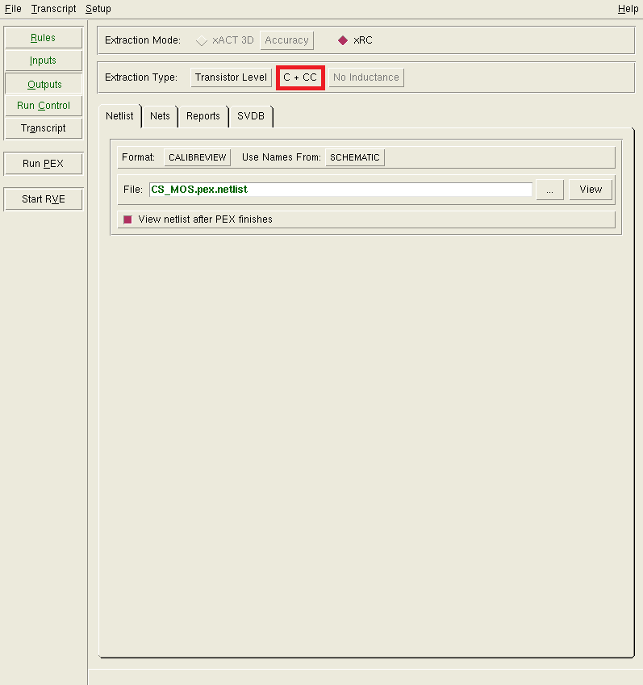
Extract C+CC with modeled parasitic resistances for better simulation performance

Slide 12
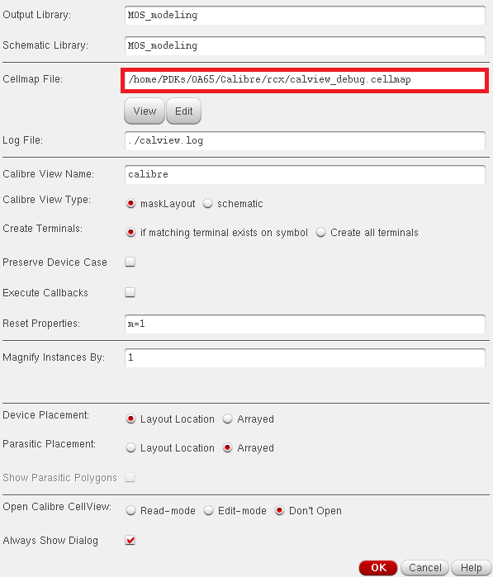
Use Cellmap file:
/home/PDKs/OA65/Calibre/rcx/calview_debug.cellmap

Slide 13
Model Comparison Result
THz MOS
THz_NMOS_CS
Analog MOS
MOS_BGDSGB_CG
MOS_SGDGS_CS
MOS_BSGGDB_Gilbert
Power MOS
PowerM_CSAr
PowerM_CCAr_longL

Slide 14
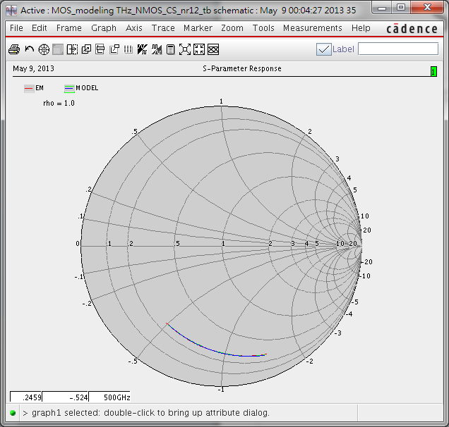
S11 (wr400n_nr12)

Slide 15
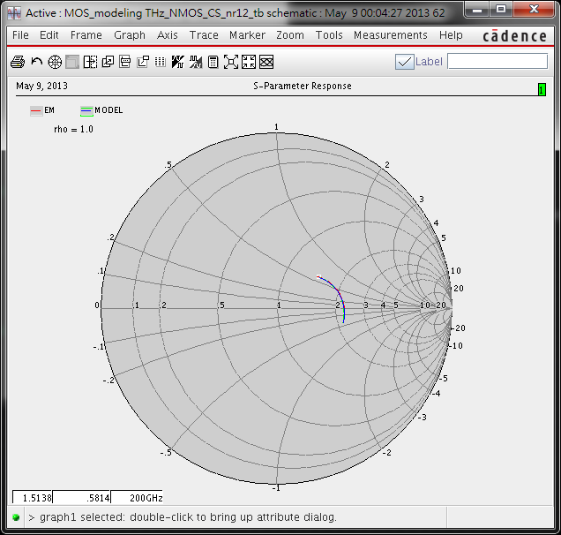
S12 (wr400n_nr12)

Slide 16
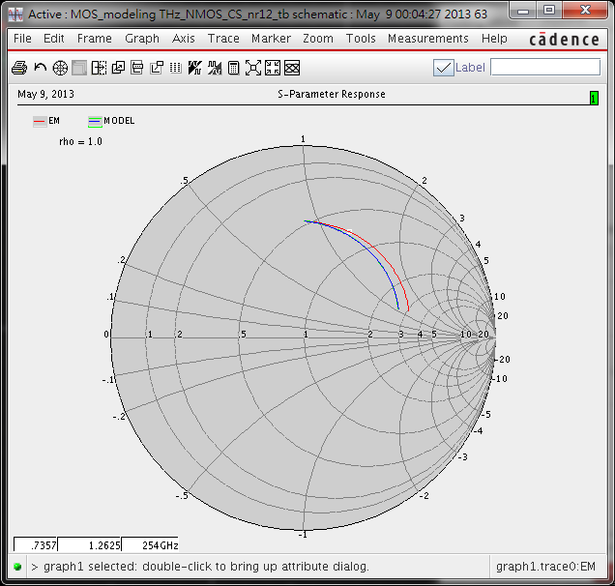
S21 (wr400n_nr12)

Slide 17
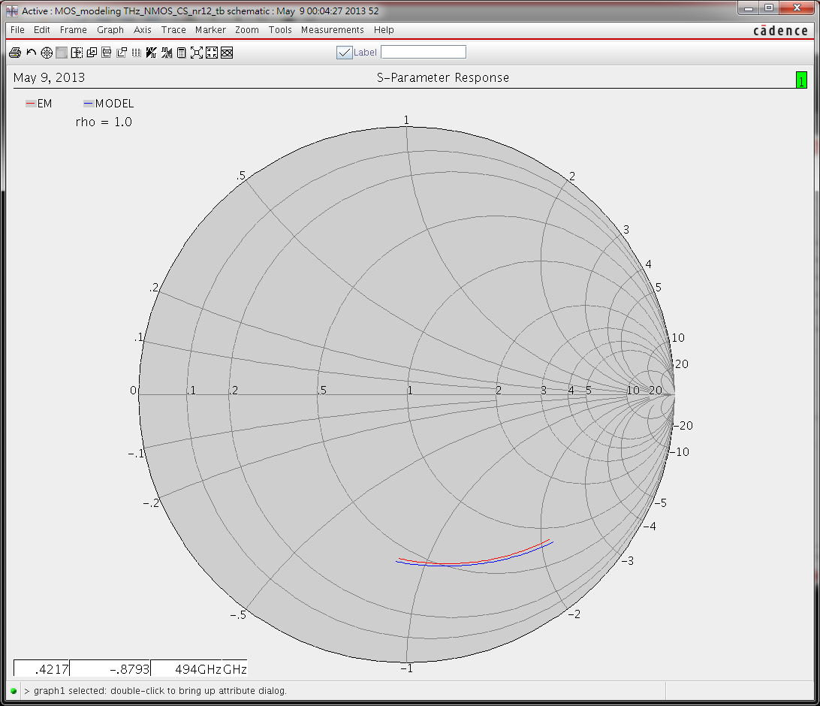
S22 (wr400n_nr12)

Slide 18
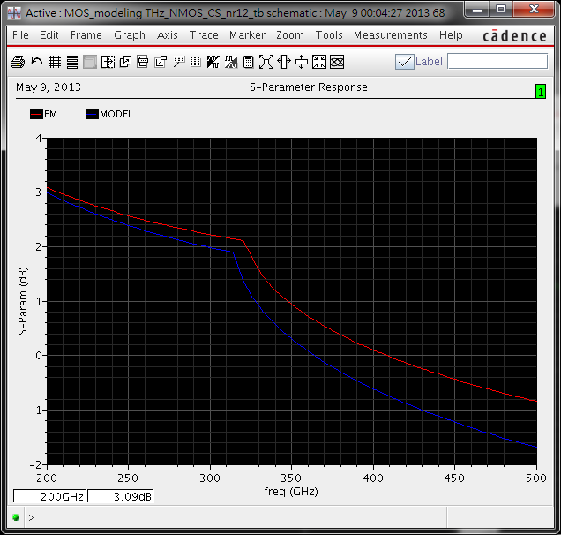
fmax wr400n_nr12

Slide 19
Model Comparison Result
THz MOS
THz_NMOS_CS
Analog MOS
MOS_BGDSGB_CG
MOS_SGDGS_CS
MOS_BSGGDB_Gilbert
Power MOS
PowerM_CSAr
PowerM_CCAr_longL

Slide 20
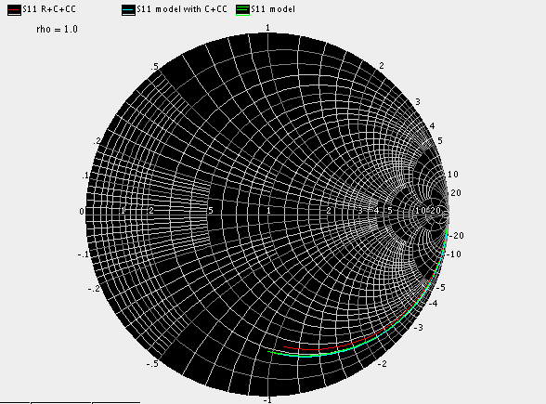
MOS_BGDSGB_CG @ (60n/1u/20)
S11

Slide 21
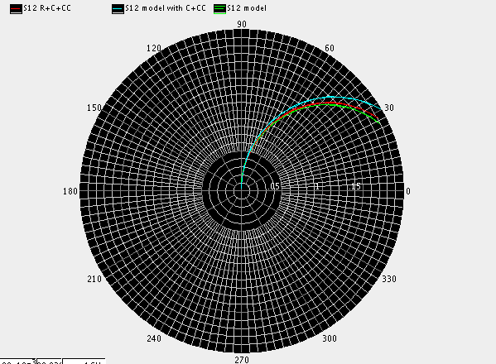
MOS_BGDSGB_CG @ (60n/1u/20)
S12

Slide 22
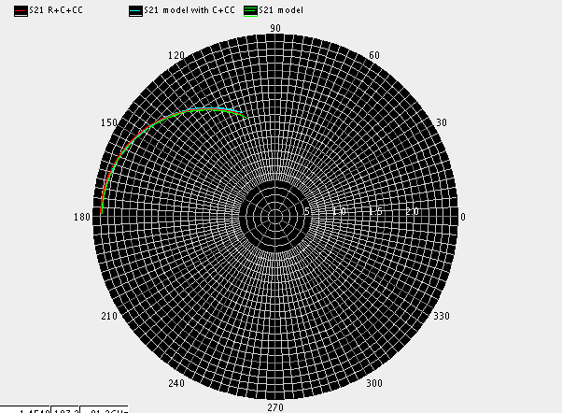
MOS_BGDSGB_CG @ (60n/1u/20)
S21

Slide 23
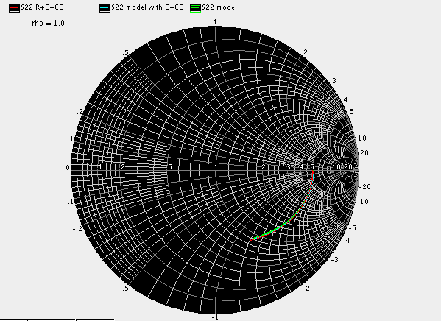
MOS_BGDSGB_CG @ (60n/1u/20)
S22

Slide 24
MOS_BGDSGB_CG @ (60n/1u/20)
R + C + CC : Id = 12.38 mA
C + CC with model : Id = 12.11 mA
model : Id = 12.11 mA

Slide 25
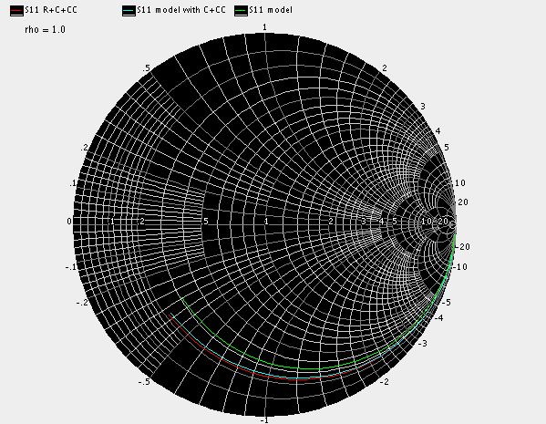
MOS_BGDSGB_CG @ (60n/1u/50) 2Rg*3.2
S11

Slide 26
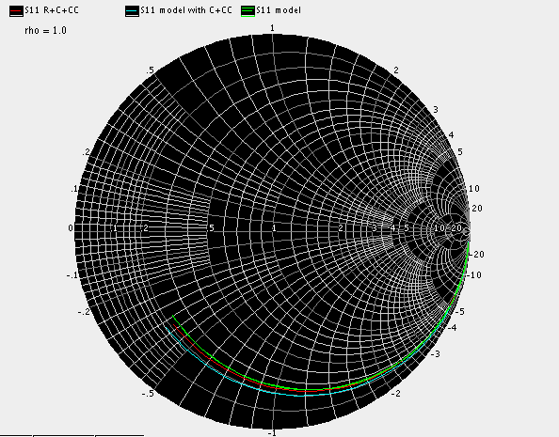
MOS_BGDSGB_CG @ (60n/1u/50) 2Rg*2
S11

Slide 27
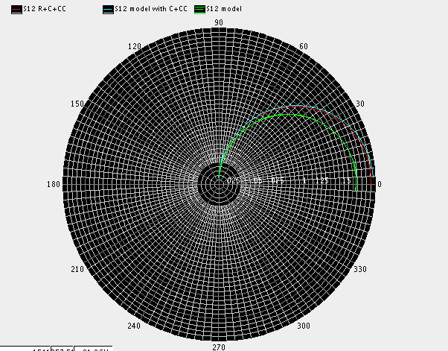
MOS_BGDSGB_CG @ (60n/1u/50) 2Rg*3.2
S12

Slide 28
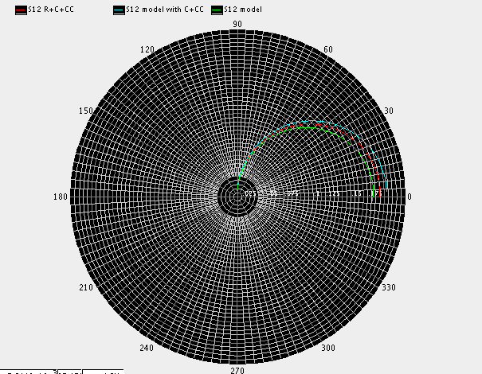
MOS_BGDSGB_CG @ (60n/1u/50) 2Rg*2
S12

Slide 29
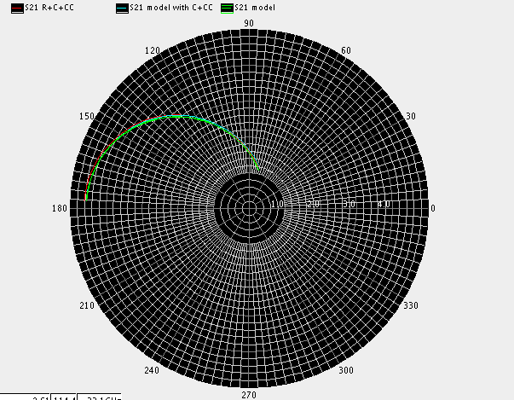
MOS_BGDSGB_CG @ (60n/1u/50)
S21

Slide 30
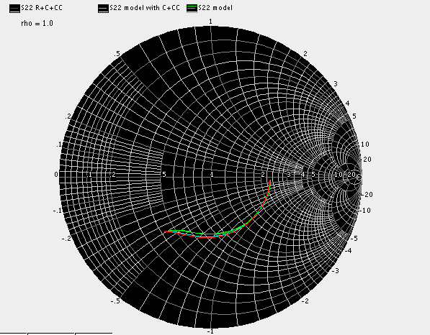
MOS_BGDSGB_CG @ (60n/1u/50)
S22

Slide 31
MOS_BGDSGB_CG @ (60n/1u/50)
R + C + CC : Id = 29.18 mA
C + CC with model : Id = 28.32 mA
model : Id = 28.32 mA

Slide 32
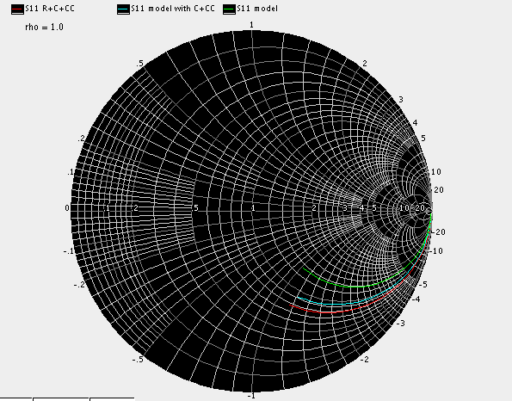
MOS_BGDSGB_CG @ (60n/2u/10) 2Rg*3.2
S11

Slide 33
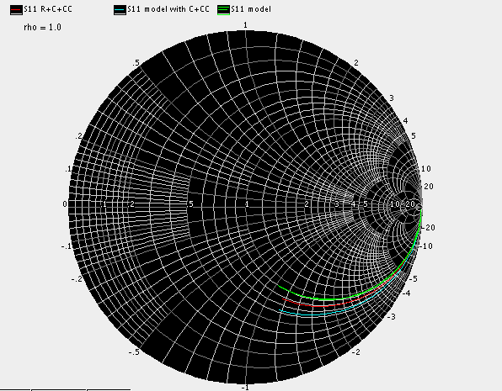
MOS_BGDSGB_CG @ (60n/2u/10) 2Rg*2
S11

Slide 34
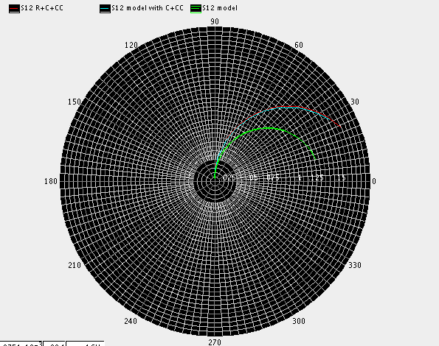
MOS_BGDSGB_CG @ (60n/2u/10) 2Rg*3.2
S12

Slide 35
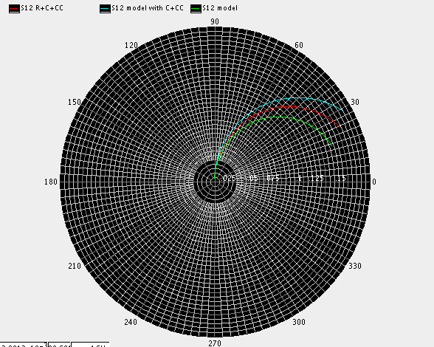
MOS_BGDSGB_CG @ (60n/2u/10) 2Rg*2
S12

Slide 36
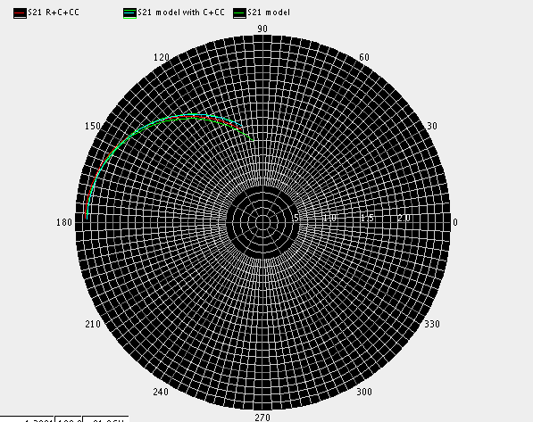
MOS_BGDSGB_CG @ (60n/2u/10)
S21

Slide 37
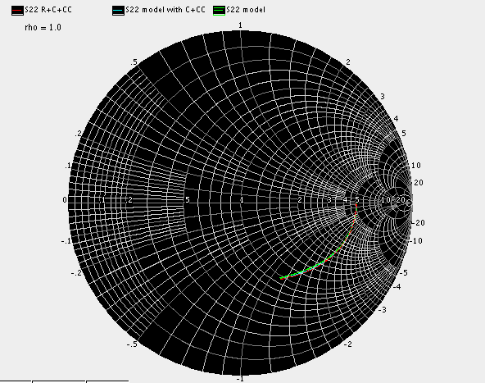
MOS_BGDSGB_CG @ (60n/2u/10)
S22

Slide 38
MOS_BGDSGB_CG @ (60n/2u/10)
R + C + CC : Id = 12.35 mA
C + CC with model : Id = 12.09 mA
model : Id = 12.09 mA

Slide 39
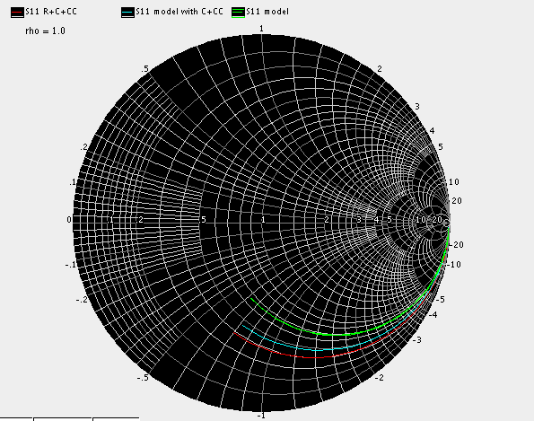
MOS_BGDSGB_CG @ (60n/1.5u/20) 2Rg*3.2
S11

Slide 40
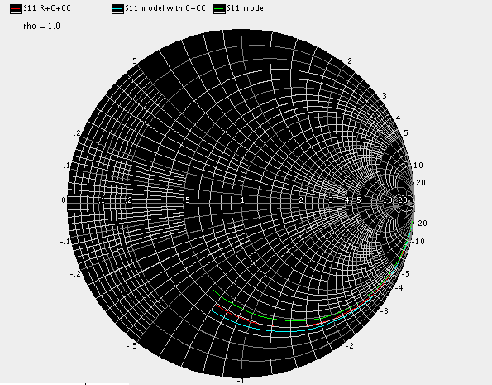
MOS_BGDSGB_CG @ (60n/1.5u/20) 2Rg*2
S11

Slide 41

MOS_BGDSGB_CG @ (60n/1.5u/20) 2Rg*3.2
S12

Slide 42
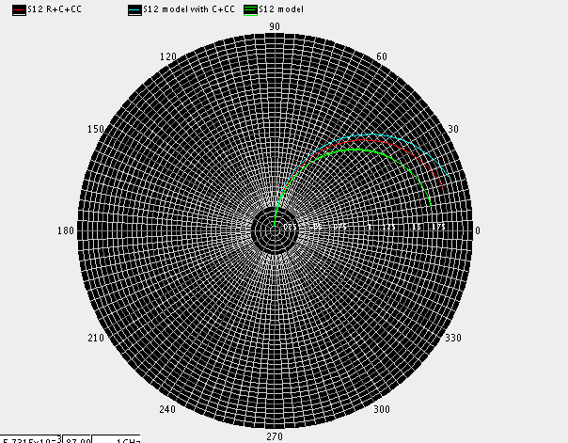
MOS_BGDSGB_CG @ (60n/1.5u/20) 2Rg*2
S12

Slide 43
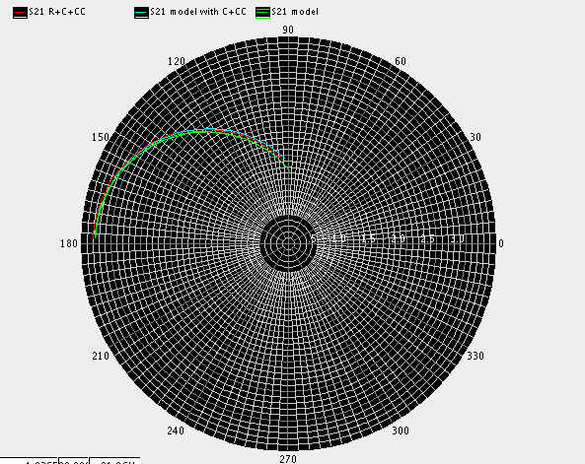
MOS_BGDSGB_CG @ (60n/1.5u/20)
S21

Slide 44
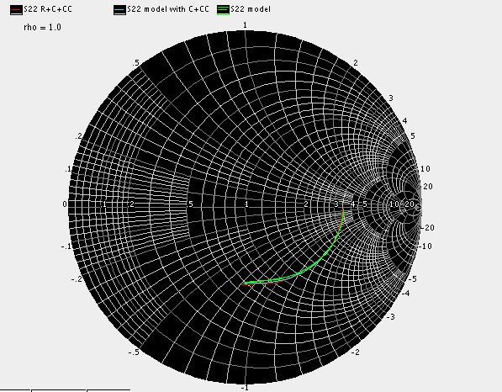
MOS_BGDSGB_CG @ (60n/1.5u/20) 2Rg*3.2
S22

Slide 45
MOS_BGDSGB_CG @ (60n/1.5u/20)
R + C + CC : Id = 18.58 mA
C + CC with model : Id = 18.1 mA
model : Id = 18.1 mA

Slide 46
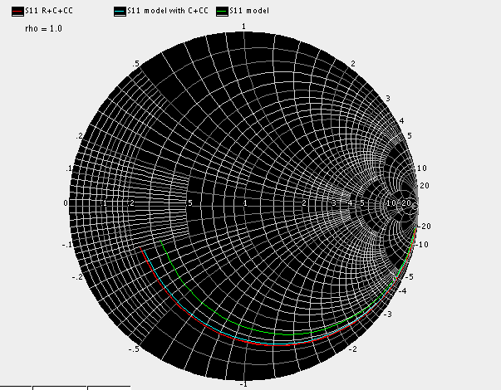
MOS_BGDSGB_CG @ (60n/2u/50) 2Rg*3.2
S11

Slide 47
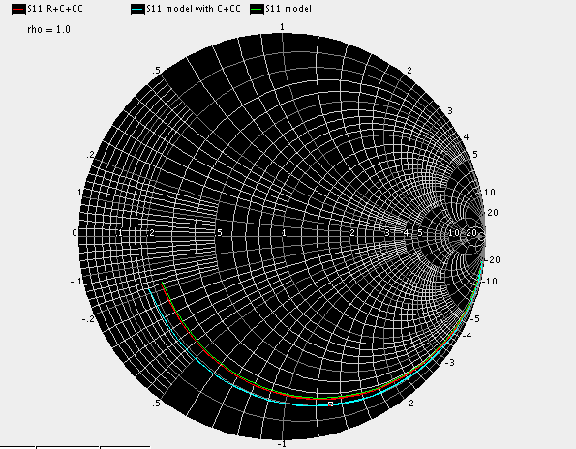
MOS_BGDSGB_CG @ (60n/2u/50) 2Rg*2
S11

Slide 48

MOS_BGDSGB_CG @ (60n/2u/50) 2Rg*3.2
S12

Slide 49

MOS_BGDSGB_CG @ (60n/2u/50) 2Rg*2
S12

Slide 50
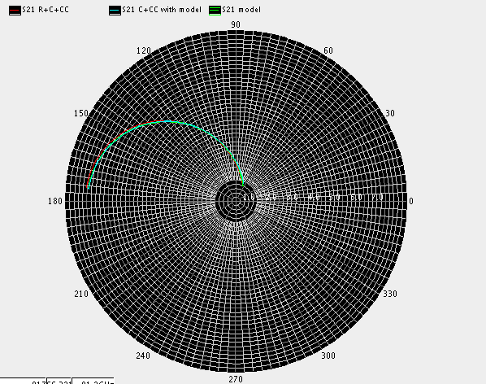
MOS_BGDSGB_CG @ (60n/2u/50)
S21

Slide 51
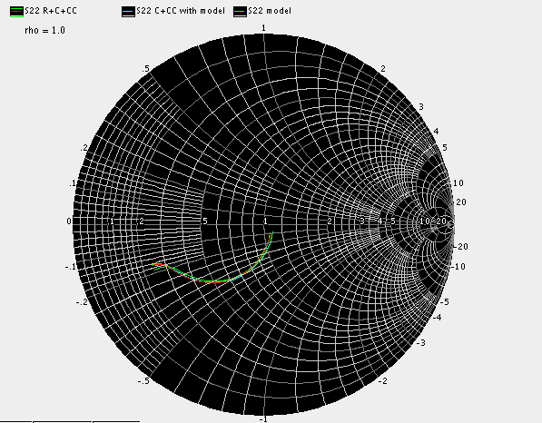
MOS_BGDSGB_CG @ (60n/2u/50)
S22

Slide 52
MOS_BGDSGB_CG @ (60n/2u/50)
R + C + CC : Id = 59.97 mA
C + CC with model : Id = 57.58 mA
model : Id = 57.58 mA

Slide 53
Model Comparison Result
THz MOS
THz_NMOS_CS
Analog MOS
MOS_BGDSGB_CG
MOS_SGDGS_CS
MOS_BSGGDB_Gilbert
Power MOS
PowerM_CSAr
PowerM_CCAr_longL

Slide 54
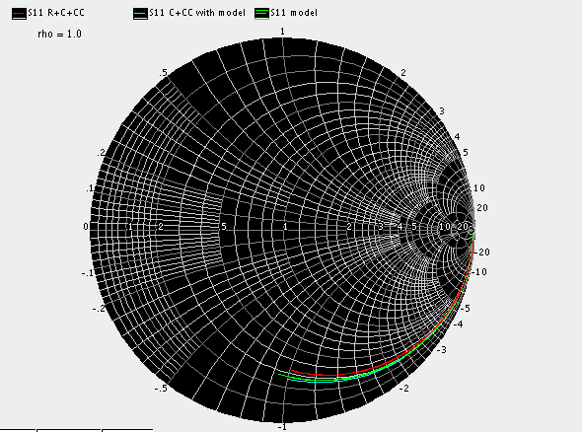
MOS_SGDGS_CS @ (60n/1u/20)
S11

Slide 55
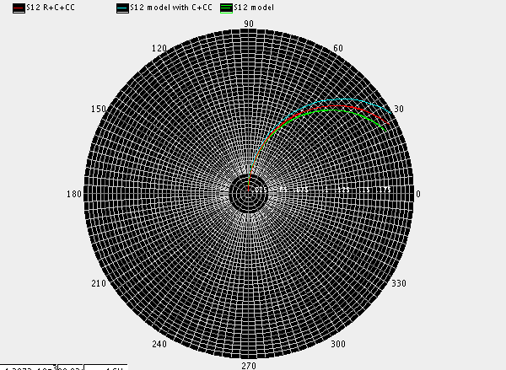
MOS_SGDGS_CS @ (60n/1u/20)
S12

Slide 56
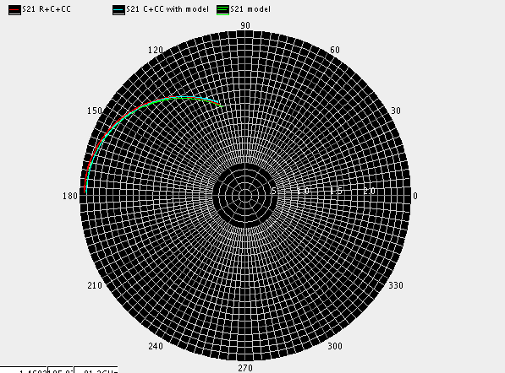
MOS_SGDGS_CS @ (60n/1u/20)
S21

Slide 57
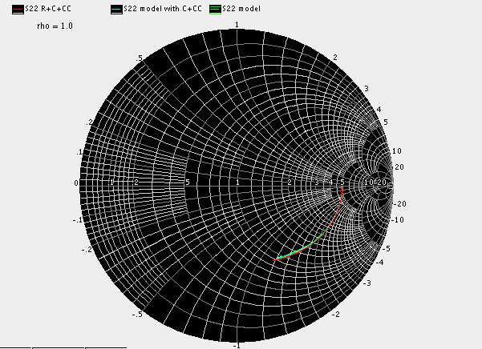
MOS_SGDGS_CS @ (60n/1u/20)
S22

Slide 58
MOS_SGDGS_CS @ (60n/1u/20)
R + C + CC : Id = 12.63 mA
C + CC with model : Id = 12.31 mA
model : Id = 12.31 mA

Slide 59
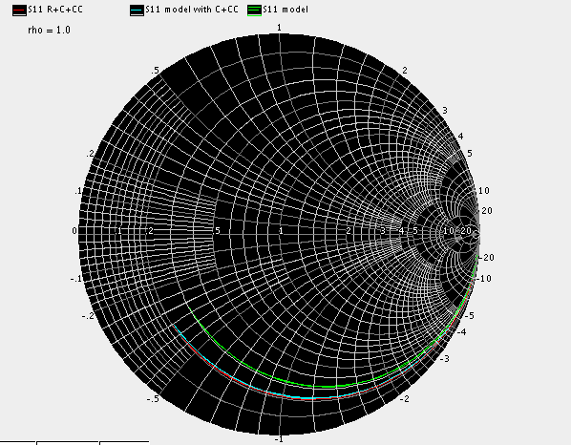
MOS_SGDGS_CS @ (60n/1u/50) 2Rg*3.2
S11

Slide 60
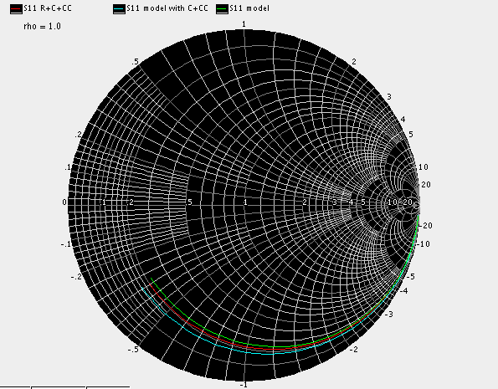
MOS_SGDGS_CS @ (60n/1u/50) 2Rg*2
S11

Slide 61
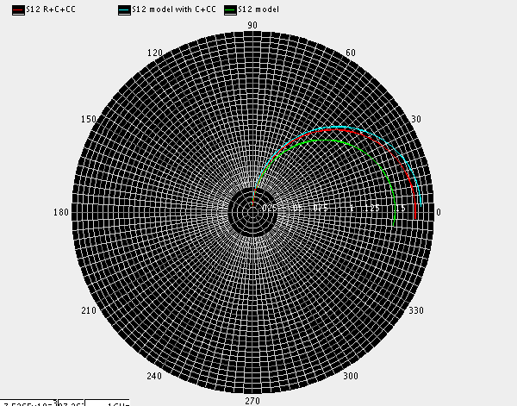
MOS_SGDGS_CS @ (60n/1u/50) 2Rg*3.2
S12

Slide 62
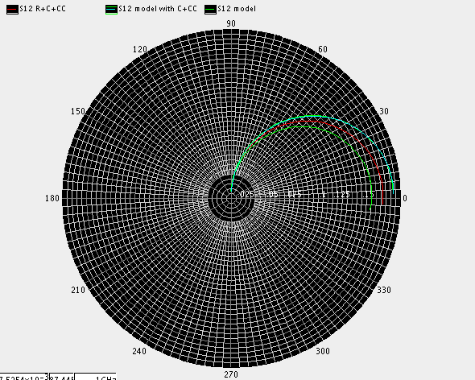
MOS_SGDGS_CS @ (60n/1u/50) 2Rg*2
S12

Slide 63
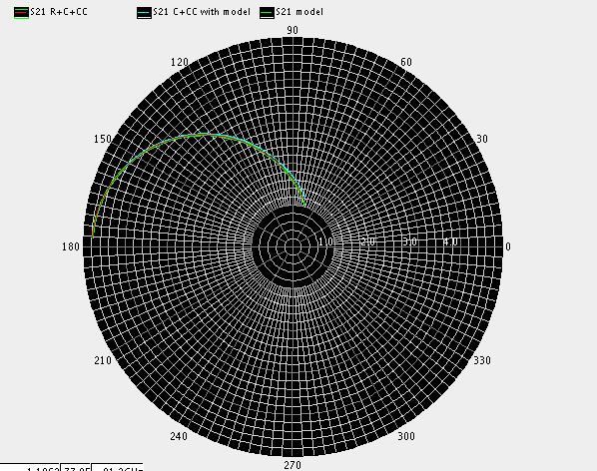
MOS_SGDGS_CS @ (60n/1u/50)
S21

Slide 64
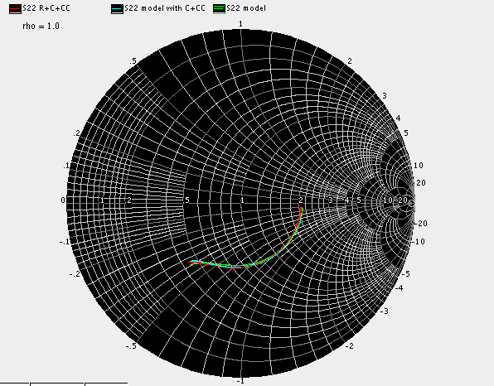
MOS_SGDGS_CS @ (60n/1u/50)
S22

Slide 65
MOS_SGDGS_CS @ (60n/1u/50)
R + C + CC : Id = 31.24 mA
C + CC with model : Id = 30.35 mA
model : Id = 30.35 mA

Slide 66
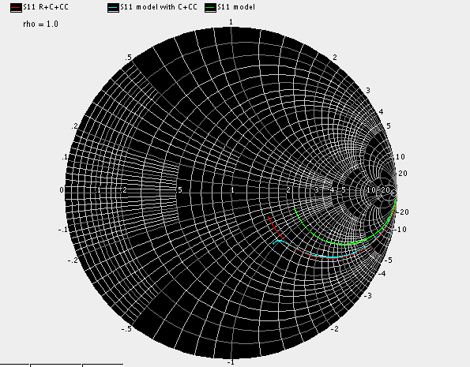
MOS_SGDGS_CS @ (60n/5u/10) 2Rg*3.2
S11

Slide 67

MOS_SGDGS_CS @ (60n/5u/10) 2Rg*2
S11

Slide 68

MOS_SGDGS_CS @ (60n/5u/10) 2Rg*3.2
S12

Slide 69

MOS_SGDGS_CS @ (60n/5u/10) 2Rg*2
S12

Slide 70

MOS_SGDGS_CS @ (60n/5u/10)
S21

Slide 71

MOS_SGDGS_CS @ (60n/5u/10)
S22

Slide 72
MOS_SGDGS_CS @ (60n/5u/10)
R + C + CC : Id = 30.07 mA
C + CC with model : Id = 29.71 mA
model : Id = 30.07 mA

Slide 73

MOS_SGDGS_CS @ (60n/2u/20)2Rg*3.2
S11

Slide 74

MOS_SGDGS_CS @ (60n/2u/20)2Rg*2
S11

Slide 75

MOS_SGDGS_CS @ (60n/2u/20) 2Rg*3.2
S12

Slide 76

MOS_SGDGS_CS @ (60n/2u/20) 2Rg*2
S12

Slide 77

MOS_SGDGS_CS @ (60n/2u/20)
S21

Slide 78

MOS_SGDGS_CS @ (60n/2u/20)
S22

Slide 79
MOS_SGDGS_CS @ (60n/2u/20)
R + C + CC : Id = 25.15 mA
C + CC with model : Id = 24.44 mA
model : Id = 24.44 mA

Slide 80

MOS_SGDGS_CS @ (60n/5u/50) 2Rg*3.2
S11

Slide 81

MOS_SGDGS_CS @ (60n/5u/50) 2Rg*2
S11

Slide 82

MOS_SGDGS_CS @ (60n/5u/50) 2Rg*3.2
S12

Slide 83

MOS_SGDGS_CS @ (60n/5u/50) 2Rg*2
S12

Slide 84

MOS_SGDGS_CS @ (60n/5u/50)
S21

Slide 85

MOS_SGDGS_CS @ (60n/5u/50)
S22

Slide 86
MOS_SGDGS_CS @ (60n/5u/50)
R + C + CC : Id = 142.2 mA
C + CC with model : Id = 137.8 mA
model : Id = 137.8 mA

Slide 87
Model Comparison Result
THz MOS
THz_NMOS_CS
Analog MOS
MOS_BGDSGB_CG
MOS_SGDGS_CS
MOS_BSGGDB_Gilbert
Power MOS
PowerM_CSAr
PowerM_CCAr_longL

Slide 88

MOS_BSGGDB_Gilbert @ (60n/1u/20)
S11

Slide 89

MOS_BSGGDB_Gilbert @ (60n/1u/20)
S12

Slide 90

MOS_BSGGDB_Gilbert @ (60n/1u/20)
S21

Slide 91

MOS_BSGGDB_Gilbert @ (60n/1u/20)
S22

Slide 92
MOS_BSGGDB_Gilbert @ (60n/1u/20)
R + C + CC : Id = 12.32 mA
C + CC with model : Id = 12.24 mA
model : Id = 12.24 mA

Slide 93

MOS_BSGGDB_Gilbert @ (60n/1u/50) Rg*3.2
S11

Slide 94

MOS_BSGGDB_Gilbert @ (60n/1u/50) Rg*2
S11

Slide 95

MOS_BSGGDB_Gilbert @ (60n/1u/50) Rg*3.2
S12

Slide 96

MOS_BSGGDB_Gilbert @ (60n/1u/50) Rg*2
S12

Slide 97

MOS_BSGGDB_Gilbert @ (60n/1u/50)
S21

Slide 98

MOS_BSGGDB_Gilbert @ (60n/1u/50)
S22

Slide 99
MOS_BSGGDB_Gilbert @ (60n/1u/50)
R + C + CC : Id = 27.7 mA
C + CC with model : Id = 26.63 mA
model : Id = 26.63 mA

Slide 100

MOS_BSGGDB_Gilbert @ (60n/5u/10) Rg*3.2
S11

Slide 101

MOS_BSGGDB_Gilbert @ (60n/5u/10) Rg*2
S11

Slide 102

MOS_BSGGDB_Gilbert @ (60n/5u/10) Rg*3.2
S12

Slide 103

MOS_BSGGDB_Gilbert @ (60n/5u/10) Rg*2
S12

Slide 104

MOS_BSGGDB_Gilbert @ (60n/5u/10)
S21

Slide 105

MOS_BSGGDB_Gilbert @ (60n/5u/10)
S22

Slide 106
MOS_BSGGDB_Gilbert @ (60n/5u/10)
R + C + CC : Id = 29.25 mA
C + CC with model : Id = 29.25 mA
model : Id = 29.25 mA

Slide 107

MOS_BSGGDB_Gilbert @ (60n/2u/20) Rg*3.2
S11

Slide 108

MOS_BSGGDB_Gilbert @ (60n/2u/20) Rg*2
S11

Slide 109

MOS_BSGGDB_Gilbert @ (60n/2u/20) Rg*3.2
S12

Slide 110

MOS_BSGGDB_Gilbert @ (60n/2u/20) Rg*2
S12

Slide 111

MOS_BSGGDB_Gilbert @ (60n/2u/20)
S21

Slide 112

MOS_BSGGDB_Gilbert @ (60n/2u/20)
S22

Slide 113
MOS_BSGGDB_Gilbert @ (60n/2u/20)
R + C + CC : Id = 24.02 mA
C + CC with model : Id = 24.12mA
model : Id = 24.12 mA

Slide 114

MOS_BSGGDB_Gilbert @ (60n/5u/50) Rg*3.2
S11

Slide 115

MOS_BSGGDB_Gilbert @ (60n/5u/50) Rg*2
S11

Slide 116

MOS_BSGGDB_Gilbert @ (60n/5u/50) Rg*3.2
S12

Slide 117

MOS_BSGGDB_Gilbert @ (60n/5u/50) Rg*2
S12

Slide 118

MOS_BSGGDB_Gilbert @ (60n/5u/50)
S21

Slide 119

MOS_BSGGDB_Gilbert @ (60n/5u/50)
S22

Slide 120
MOS_BSGGDB_Gilbert @ (60n/5u/50)
R + C + CC : Id = 92.08 mA
C + CC with model : Id = 91.66 mA
model : Id = 91.66 mA

Slide 121
Model Comparison Result
THz MOS
THz_NMOS_CS
Analog MOS
MOS_BGDSGB_CG
MOS_SGDGS_CS
MOS_BSGGDB_Gilbert
Power MOS
PowerM_CSAr
PowerM_CCAr_longL

Slide 122

S11(wr1.5u_nr100)

Slide 123

S12(wr1.5u_nr100)

Slide 124

S21(wr1.5u_nr100)

Slide 125

S22(wr1.5u_nr100)

Slide 126
(wr1.5u_nr100)
R+C+CC : Id = 83.7mA
C+CC+MODEL : Id = 87.6mA
MODEL : Id = 87.6mA

Slide 127

S11(wr1u_nr10)

Slide 128

S12(wr1u_nr10)

Slide 129

S21(wr1u_nr10)

Slide 130

S22(wr1u_nr10)

Slide 131
(wr1u_nr10)
R+C+CC : Id = 15.61mA
C+CC+MODEL : Id = 15.25mA
MODEL : Id = 15.25mA

Slide 132

S11(wr1.5u_nr50/M4)

Slide 133

S12(wr1.5u_nr50/M4)

Slide 134

S21(wr1.5u_nr50/m4)

Slide 135

S22(wr1.5u_nr50/M4)

Slide 136
(wr1.5u_nr50/M4)
R+C+CC : Id = 180.4mA
C+CC+MODEL : Id = 175.6mA
MODEL : Id = 175.6mA

Slide 137
Model Comparison Result
THz MOS
THz_NMOS_CS
Analog MOS
MOS_BGDSGB_CG
MOS_SGDGS_CS
MOS_BSGGDB_Gilbert
Power MOS
PowerM_CSAr
PowerM_CCAr_longL

Slide 138

S11(wr3.2u_wrby1.52u_nr100)

Slide 139

S12(wr3.2u_wrby1.52u_nr100)

Slide 140

S21(wr3.2u_wrby1.52u_nr100)

Slide 141

S22(wr3.2u_wrby1.52u_nr100)

Slide 142
(wr3.2u_wrby1.52u_nr100)
R+C+CC: Id = 50.52mA
C+CC+MODEL: Id = 60.3mA

Slide 143

S11(wr3.2u_wrby1.52u_nr32/M4)

Slide 144

S12(wr3.2u_wrby1.52u_nr32/M4)

Slide 145

S21(wr3.2u_wrby1.52u_nr32/M4)

Slide 146

S22(wr3.2u_wrby1.52u_nr32/M4)

Slide 147
(wr3.2u_wrby1.52u_nr32/M4)
R+C+CC: Id = 32.08mA
C+CC+MODEL: Id = 39.59mA

